Slide 1
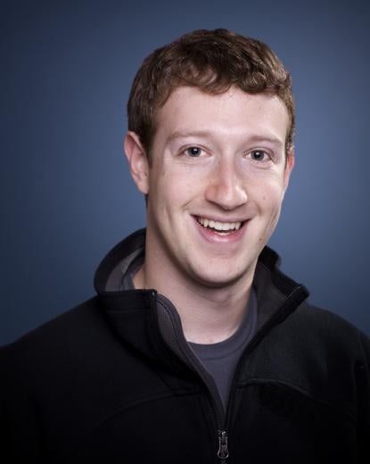



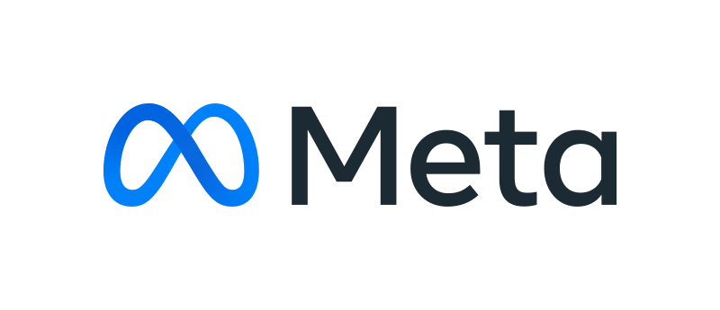


Mark
Zuckerberg
Mark Zuckerberg , known as co-founder, chairman and CEO of Meta Platforms.
(Born May 14 ,1984)
~ By Jastina~

Slide 2
Mark
Zuckerberg
The WhatsApp Effect
Revolutionized Messaging – WhatsApp transformed communication by making instant messaging fast, simple, and accessible worldwide, replacing traditional SMS with internet-based texting, voice notes, and calls.Changed Communication Habits – People began relying on quick, real-time messaging through chats and groups, leading to constant connectivity, faster responses, and more informal, everyday communication styles.
Mark Zuckerberg , known as co-founder, chairman and CEO of Meta Platforms.
(born May 14 ,1984)
Mark Zuckerberg

Slide 3
Mark
Zuckerberg
The FaceBook Effect
Revolutionized Social Networking – Facebook turned online social networking from niche websites into a mainstream way for people to connect, share updates, photos, and ideas globally.
Changed Communication Habits – People began interacting more digitally than in person for certain social interactions, leading to the rise of instant messaging, likes, and news feeds as central forms of communication.
Mark Zuckerberg , known as co-founder, chairman and CEO of Meta Platforms.
(born May 14 ,1984)
Mark Zuckerberg

Slide 4
Mark
Zuckerberg
The Threads Effect
Redefined Microblogging Conversations – Threads introduced a fresh, Instagram-linked platform focused on short text updates, making public conversations more casual, real-time, and community-driven.Changed Online Interaction Style – People began sharing quick thoughts, opinions, and updates in a more relaxed and conversational way, shifting from highly curated posts to spontaneous and authentic expression.
Mark Zuckerberg , known as co-founder, chairman and CEO of Meta Platforms.
(born May 14 ,1984)
Mark Zuckerberg

Slide 5
Mark
Zuckerberg
The Instagram Effect
Expansion & Integration• Acquisition (2012): Zuckerberg bought Instagram for $1 billion, integrating it into Meta’s ecosystem.• Growth: Instagram’s user base skyrocketed from ~30 million at acquisition to over 2 billion monthly active users today.• Integration with Facebook: Cross-platform features like shared messaging, ads, and business tools strengthened Meta’s dominance.
Mark Zuckerberg , known as co-founder, chairman and CEO of Meta Platforms.
(born May 14 ,1984)
Mark Zuckerberg

Slide 6
Mark
Zuckerberg
The Meta Effect
Unified Digital Ecosystem – Meta Platforms connected multiple platforms like Facebook, Instagram, and WhatsApp under one umbrella, creating a seamless global network for communication, content sharing, and business.
Expanded the Future of Social Technology – Meta shifted focus toward immersive experiences like virtual and augmented reality, changing how people interact online by introducing concepts like the metaverse and more interactive digital spaces.
Mark Zuckerberg , known as co-founder, chairman and CEO of Meta Platforms.
(born May 14 ,1984)
Mark Zuckerberg

Slide 7
🏠
Local
Mark
Zuckerberg
👥
Problem – Limited Ways to Connect in Small Communities Before social platforms, people in schools or local communities had fewer easy ways to stay connected outside physical spaces.
Contribution – Created Facebook for Campus Connection Zuckerberg initially launched Facebook to help students connect, share updates, and build a sense of community within their university, making communication easier and more interactive.
Mark Zuckerberg , known as co-founder, chairman and CEO of Meta Platforms.
(born May 14 ,1984)
Mark Zuckerberg
📱

Slide 8
🗺️
National
Mark
Zuckerberg
📞
Problem – Slow and Limited Digital Communication Communication across cities in a country relied heavily on calls, emails, or SMS, which were less interactive and slower.
Contribution – Scaled Social Networking Across the Country Facebook expanded nationwide, allowing people to instantly share news, communicate, and build networks across regions, helping businesses, communities, and individuals stay connected.
Mark Zuckerberg , known as co-founder, chairman and CEO of Meta Platforms.
(born May 14 ,1984)
Mark Zuckerberg
💬

Slide 9
🌍
Global
Mark
Zuckerberg
❌
Problem – Lack of a Unified Global Communication Platform
There was no single platform where people worldwide could easily connect, share ideas, and communicate in real time.
Contribution – Built a Global Social Network Zuckerberg turned Facebook into a worldwide platform, connecting billions of people, enabling global communication, cultural exchange, online communities, and even business growth across borders.
Mark Zuckerberg , known as co-founder, chairman and CEO of Meta Platforms.
(born May 14 ,1984)
Mark Zuckerberg
🤝

Slide 10
🌍
Global
Mark
Zuckerberg
❌
Level | Reach | Users | Speed | Influence
Local | 5% | Hundreds | Medium | Low
National | 25% | Millions | Fast | Moderate
Global | 100% | Billions | Instant | Very High
Problem – Lack of a Unified Global Communication Platform
There was no single platform where people worldwide could easily connect, share ideas, and communicate in real time.
Contribution – Built a Global Social Network Zuckerberg turned Facebook into a worldwide platform, connecting billions of people, enabling global communication, cultural exchange, online communities, and even business growth across borders.
Mark Zuckerberg , known as co-founder, chairman and CEO of Meta Platforms.
(born May 14 ,1984)
Mark Zuckerberg
🤝

Slide 11
Quotes
Global
🌍
Mark
Zuckerberg
❌
Problem – Lack of a Unified Global Communication Platform
There was no single platform where people worldwide could easily connect, share ideas, and communicate in real time.
Contribution – Built a Global Social Network Zuckerberg turned Facebook into a worldwide platform, connecting billions of people, enabling global communication, cultural exchange, online communities, and even business growth across borders.
Move fast and break things. Unless you are breaking stuff, you are not moving fast enough.
Mark Zuckerberg , known as co-founder, chairman and CEO of Meta Platforms.
(born May 14 ,1984)
Mark Zuckerberg
🤝

Slide 12


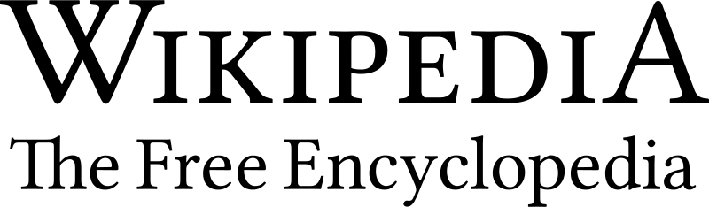


Sources & Credits
🌍
Global
Mark
Zuckerberg
❌
Problem – Lack of a Unified Global Communication Platform
There was no single platform where people worldwide could easily connect, share ideas, and communicate in real time.
Contribution – Built a Global Social Network Zuckerberg turned Facebook into a worldwide platform, connecting billions of people, enabling global communication, cultural exchange, online communities, and even business growth across borders.
Mark Zuckerberg , known as co-founder, chairman and CEO of Meta Platforms.
(born May 14 ,1984)
Mark Zuckerberg
Classmate: Neel
🤝

Slide 13
🌍
Global
Mark
Zuckerberg
❌
Problem – Lack of a Unified Global Communication Platform
There was no single platform where people worldwide could easily connect, share ideas, and communicate in real time.
Contribution – Built a Global Social Network Zuckerberg turned Facebook into a worldwide platform, connecting billions of people, enabling global communication, cultural exchange, online communities, and even business growth across borders.
Thank You
Mark Zuckerberg , known as co-founder, chairman and CEO of Meta Platforms.
(born May 14 ,1984)
Mark Zuckerberg
~ By Jastina~
🤝

